Slide 1
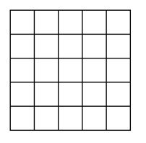
Mario Kart micro:bit.
Activity #1
Mario Kart Unplugged.
Draw the animations you would like to the Mario Kart drivers to see. Label the sequence of your animation and how frequently it repeats

Slide 2
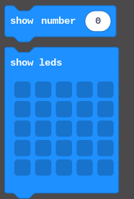
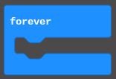
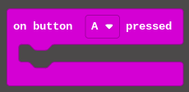
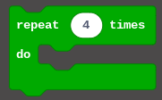
Mario Kart Animations.
Activity #2
Use these code blocks to create animations:
Micro:bit Coding.
Task 1: Use the A & B input buttons to create animations on your microbit
​Task 2: Loop an animation on the microbit
Challenges:
Use the 'Shake' and 'on Pin Press' input blocks to show animations
Use the sound blocks (if Microbit v2) to create driver notifications

Slide 3
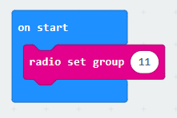
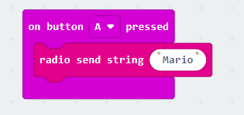
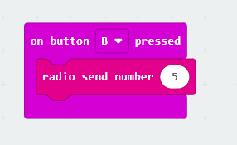
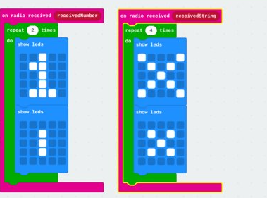
Mario Kart Animations.
Activity #3
Micro:bit Radio Coding.
Use these code blocks to create these animations:
Task: On two micro:bits, use the micro:bit radio blocks to broadcast from one micro:bit and show animations on the other
Challenge: Use the radio blocks to broadcast messages and sounds (if V2) between several micro:bits

